Slide 1


Introduction to Groovy
CDP JaMP
Andrii Korkoshko
Software Engineer
OCTOBER 11, 2016

Slide 2
Agenda
1
What is Groovy?
2
Getting started with Groovy
3
Differences between Java and Groovy
4
Groovy features
5
Testing with Groovy
6
Grails

Slide 3

WHAT IS GROOVY?

Slide 4
What is Groovy?
Groovy
is an object-oriented programming language for the Java platform.
It is a dynamic language for the Java platform with features similar to those of Python, Ruby, Perl, and Smalltalk.
Groovy is dynamically compiled to Java Virtual Machine (JVM) bytecode.
Seamlessly and transparently integrates and interoperates with Java and any third-party libraries.
It can be used as a scripting language for the Java Platform.

Slide 5
Ok, that’s cool. But why do I need it?
1
Extend view about platform
2
Discover new things, which you can easily use in you projects
3
To show you new abilities for the future self development
4
To extend your comprehension about different programming approaches

Slide 6
Getting started

Slide 7
Groovy installation
Installation to the system
Download from official site: http://groovy-lang.org/download.html
Unpack somewhere and add the environment variable:
export GROOVY_HOME=~/path/to/groovy/
export PATH=$GROOVY_HOME/bin:$PATH
Use IDE plugin
For Intellij Idea you can use groovy plugin for making your work easier: https://www.jetbrains.com/idea/help/getting-started-with-groovy.html
Plugin for Eclipse also exists:
http://docs.groovy-lang.org/latest/html/documentation/tools-groovyeclipse.html

Slide 8
Groovy installation
Use dependency in building tool
Just the core of Groovy without the modules
Different groovy modules ("ant", "bsf", "console", "docgenerator", "groovydoc", "groovysh", "jmx", "json", "jsr223", "nio", "servlet", "sql", "swing", "test", "templates", "testng" and "xml“)
The core plus all the modules.
<groupId>org.codehaus.groovy</groupId> <artifactId>groovy</artifactId> <version>x.y.z</version>
<groupId>org.codehaus.groovy</groupId> <artifactId>groovy-$module</artifactId> <version>x.y.z</version>
<groupId>org.codehaus.groovy</groupId> <artifactId>groovy-all</artifactId> <version>x.y.z</version>

Slide 9
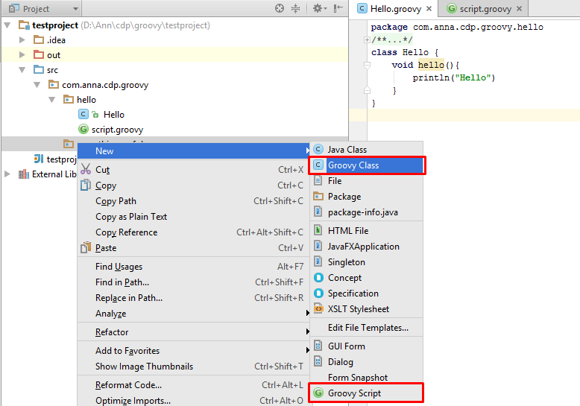
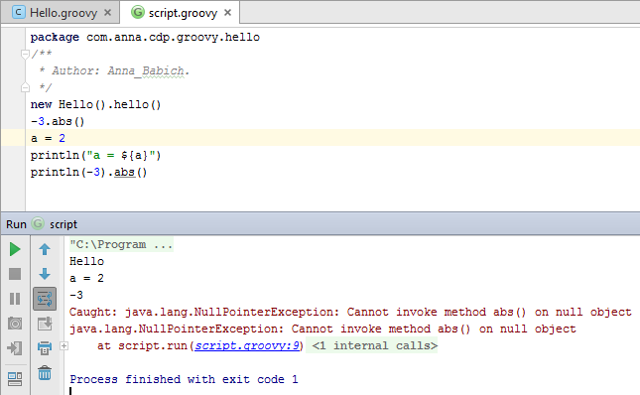
Hello world

Slide 10
Groovy features

Slide 11
Differences with Java
In Groovy, the methods which will be invoked are chosen at runtime.
Default imports. All these packages and classes are imported by default, i.e. you do not have to use an explicit import statement to use them: java.io.*; java.lang.*; java.math.BigDecimal; java.math.BigInteger; java.net.*; java.util.* groovy.lang.*; groovy.util.*
In Groovy, omitting a modifier on a field means a private field, an associated getter and an associated setter.
Array initializers: int[] array = [1,2,3]
The implementation of anonymous inner classes and nested classes done looks much like what we do for groovy.lang.Closure, but not absolutely like in Java. (Accessing private fields and methods for example can become a problem, but on the other hand local variables don’t have to be final.)
Default must be last in switch case
Notes:
Java: public static X createX(Y y) { return y.new X(); }
Groovy: public static X createX(Y y) { return new X(y) }
Closure

Slide 12
Differences with Java
In Groovy, the methods which will be invoked are chosen at runtime.
Example:
int method(String arg) {
return 1;
}
int method(Object arg) {
return 2;
}
Object o = "Object";
int result = method(o);
Java
assertEquals(2, result);
Groovy
assertEquals(1, result);

Slide 13
Differences and features
Closures instead of lambdas
GStrings
Java Strings — single quotes ‘It is Java String’ Groovy Strings, (GStrings) — double quotes “It is GString. And this is a value of variable: ${variable}”
Multiline String - triple quotes
Because Groovy uses Objects for everything, it autowraps references to primitives.
In Groovy == translates to a.compareTo(b)==0, if they are Comparable, and a.equals(b) otherwise. To check for identity, there is is. E.g. a.is(b).
Java does automatic widening and narrowing conversions. Groovy expands greatly on this.
There are a few more keywords in Groovy than in Java. Don’t use them for variable names: as, def, in, trait.
Notes:
int i m(i)
void m(long l) { println "in m(long)" } java
void m(Integer i) { println "in m(Integer)" } java

Slide 14
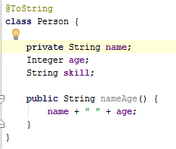
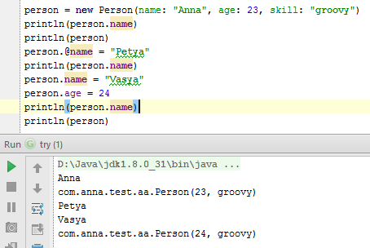
Groovy beans OR private is not private

Slide 15
Lists and Arrays
Groovy uses a comma-separated list of values, surrounded by square brackets, to denote lists: [1, 2, 3]
To change list implementation: [1, 2, 3] as LinkedList.
Accessing elements:
def letters = ['a', 'b', 'c', 'd']
letters[1] == 'b‘ gets element by number
letters[-2] == 'c‘ gets element by number from the end
letters[2] = 'C' sets element by number
letters << 'e'
letters[1, 3] == ['b', 'd'] gets elements by numbers
assert letters[2..4] == ['C', 'd', 'e'] gets elements by range

Slide 16
Maps
Sometimes called dictionaries or associative arrays in other languages, Groovy features maps. Maps associate keys to values, separating keys and values with colons, and each key/value pairs with commas, and the whole keys and values surrounded by square brackets.
Groovy creates maps that are actually instances of java.util.LinkedHashMap
Accessing elements:
def colors = [red: '#FF0000', green: '#00FF00', blue: '#0000FF']
assert colors['red'] == '#FF0000'
assert colors.green == '#00FF00'
colors['pink'] = '#FF00FF'
colors.yellow = '#FFFF00'
def key = 'name‘
person = [(key): 'Guillaume‘] to use variable as a key

Slide 17
Groovy operators
Groovy has ** operator, which is power operator.
2 ** 3 = 8
Safe navigation operator
def name = person?.name
If person is null, the name also will be null. NullPointerExcepion will not be thrown.
Field accessors.
person.name - calls the getter (equals to person.getName() in Java)
person.@name - use of .@ forces usage of the field instead of the getter
The method pointer operator.
def fun = str.&toUpperCase
def upper = fun()
Stores a reference to a method in a variable, in order to call it later.
Groovy operators

Slide 18
Groovy operators
Range operator
def range = 0..5
(0..5).collect() == [0, 1, 2, 3, 4, 5]
(0..<5).collect() == [0, 1, 2, 3, 4]
(0..5) instanceof List
(0..5).size() == 6
You can create a range from any Comparable object that has next() and previous() methods to determine the next / previous item in the range.
The spaceship operator (<=>) delegates to the compareTo method
The membership operator (in) is equivalent to calling the isCase method. In the context of a List, it is equivalent to calling contains
The call operator () is used to call a method named call implicitly. For any object which defines a call method, you can omit the .call part and use the call operator instead:
class MyCallable {
int call(int x) {
2*x
}
}
def mc = new MyCallable()
mc(2) == 4

Slide 19
Groovy operators. Spread operator
The Spread Operator (*.) is used to invoke an action on all items of an aggregate object. It is equivalent to calling the action on each item and collecting the result into a list:
The spread operator is null-safe.
Spread list elements
def items = [4,5]
def list = [1,2,3,*items,6]
Spread function arguments
int function(int x, int y, int z) {
x*y+z
}
def args = [4,5,6]
assert function(*args) == 26
def persons = [new Person(name: "Anna", age: 23), new Person(name: "Andrew", age: 22)] print(persons*.nameAge())
[Anna 23, Andrew 21]

Slide 20
Operator overloading
Groovy allows you to overload the various operators so that they can be used with your own classes. Consider this simple class:
@ToString(includeNames = true) class Bucket { int size Bucket(int size) { this.size = size } Bucket plus(Bucket other) { return new Bucket(this.size + other.size) } }
Bucket bucket = new Bucket(5) + new Bucket(10); println(bucket);
Result: com.anna.test.Bucket(size:15)

Slide 21
Closures
A closure in Groovy is an open, anonymous, block of code that can take arguments, return a value and be assigned to a variable. Closure in the Groovy language can contain free variables which are defined outside of its surrounding scope.
{ [closureParameters -> ] statements }
Examples:
{ item++ } variable from scope outside
{ println it } implicit parameter
{ String x, int y ->
println "hey ${x} the value is ${y}"
}
{ reader ->
def line = reader.readLine()
line.trim()
}

Slide 22
Closures
To call closure
it is implicit parameter:
To prevent using implicit parameter use -> operator
def closure = {param -> println param} closure("Some text")
closure.call("Some text")
def closure = { it++ println(it) } closure(5)
def closure = { -> println("constant") } closure(5)
Will produce exception:
Caught: groovy.lang.MissingMethodException: No signature of method …

Slide 23
Closures
this: refers to the instance of the class that the closure was defined in.
owner: is the same as this, unless the closure was defined inside another closure in which case the owner refers to the outer closure.
delegate: is the same as owner. But, it is the only one that can be programmatically changed, and it is the one that makes Groovy closures really powerful.
class MyClass { def outerClosure = { println this.class.name // outputs MyClass println owner.class.name // outputs MyClass println delegate.class.name //outputs MyClass def nestedClosure = { println this.class.name // outputs MyClass println owner.class.name // outputs MyClass$_closure1 println delegate.class.name // outputs MyClass$_closure1 } nestedClosure() } } def closure = new MyClass().outerClosure closure()

Slide 24
Closures
Default resolving strategy
this
owner
delegate
Every closure has a property called resolvedStrategy. This can be set to:
Closure.OWNER_FIRST
Closure.DELEGATE_FIRST
Closure.OWNER_ONLY
Closure.DELEGATE_ONLY

Slide 25
Groovy Testing

Slide 26
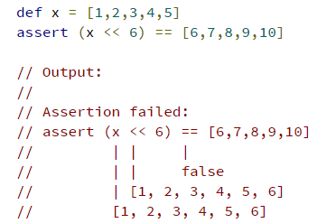
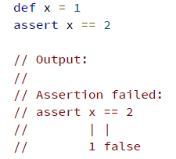
Groovy Testing
Power Assertions
Groovy comes with a powerful variant of assert also known as power assertion statement. Groovy’s power assert differs from the Java version in its output given the boolean expression validates to false:

Slide 27
Map & closure coercion
class TranslationService { String convert(String key) { return "test" } }
def service = [convert: { String key -> 'some text' }] as TranslationService assert 'some text' == service.convert('key.text')
Map coercion
Closure coercion
def service = { String key -> 'some text' } as TranslationService assert 'some text' == service.convert('key.text')
abstract class BaseService { abstract void doSomething() } BaseService service = { -> println 'doing something' } service.doSomething()

Slide 28
Mocking and Stubbing
def mock = new MockFor(Person) // StubFor(Person)
//a new mock is created by a new instance of MockFor mock.demand.getFirst { 'dummy' } mock.demand.getLast { 'name' }
mock.use {
//a Closure is passed to use which enables the mocking functionality def mary = new Person(first: 'Mary', last: 'Smith') def f = new Family(mother: mary) assert f.nameOfMother() == 'dummy name' }
mock.expect.verify()
//a call to verify checks whether the sequence and number
of method calls is as expected

Slide 29
Test data generation
Combinations:
The combinations method that is added on java.lang.Iterable compliant classes can be used to get a list of combinations from a list containing two or more sub-lists:
void testCombinations() {
def combinations = [[2, 3],[4, 5, 6]].combinations()
assert combinations == [[2, 4], [3, 4], [2, 5], [3, 5], [2, 6], [3, 6]] }
EachCombination:
EachCombination is a GDK method that is added to all classes conforming to the java.lang.Iterable interface. It applies a function on each combination of the input lists:
void testEachCombination() {
[[2, 3],[4, 5, 6]].eachCombination { println it[0] + it[1] } }
Clone

Slide 30
Unit Tests with JUnit
GroovyTestCase is inherited from junit.framework.TestCase therefore it inherits a large number of assertion methods being available to be called in every test method:
class MyTestCase extends GroovyTestCase {
void testAssertions() {
assertTrue(1 == 1)
assertEquals("test", "test")
def x = "42"
assertNotNull "x must not be null", x
assertNull null
assertSame x, x
}}
void testScriptAssertions() {
assertScript '''
def x = 1
def y = 2
assert x + y == 3
'''
}

Slide 31
Unit Tests with JUnit
ShouldFail can be used to check whether the given code block fails or not. In case it fails, the assertion does hold, otherwise the assertion fails:
void testInvalidIndexAccess1() {
def numbers = [1,2,3,4]
shouldFail {
numbers.get(4)
}
}
void testInvalidIndexAccess2() {
def numbers = [1,2,3,4]
def msg = shouldFail IndexOutOfBoundsException, {
numbers.get(4)
}
assert msg.contains('Index: 4, Size: 4')
}
If anything other than IndexOutOfBoundsException (or a descendant class of it) is thrown, the test case will fail.
A pretty nice feature of shouldFail hasn’t been visible so far: it returns the exception message. This is really useful if you want to assert on the exception error message.

Slide 32
Specifications
Spock specification classes are derived from spock.lang.Specification. A concrete specification class might consist of fields, fixture methods, features methods and helper methods.
Let’s have a look at a simple specification with a single feature method for an imaginary Stack class:
class StackSpec extends Specification {
def "adding an element leads to size increase"() { (1)
setup: "a new stack instance is created" (2)
def stack = new Stack()
when: (3)
stack.push 42
then: (4)
stack.size() == 1
}}
1. Feature method, is by convention named with a String literal.
2. Setup block, here is where any setup work for this feature needs to be done.
3. When block describes a stimulus, a certain action under target by this feature specification.
4. Then block any expressions that can be used to validate the result of the code that was triggered by the when block.

Slide 33
Introduction to Grails
is a powerful web framework, for the Java platform aimed at multiplying developers’ productivity thanks to a Convention-over-Configuration, sensible defaults and opinionated APIs.
Download:
grails create-app helloworld
grails> create-controller hello
grails> create-domain-class hello
grails> generate-view helloworld.Hello
grails> run-app
Grails
https://grails.org/download.html

Slide 34
Q&A
Do you have any questions?

Slide 35
Thank you!

